Slide 1
JAVA SERVER FACES
PrimeFaces
By NGUYỄN THANH NHÃ
nguyen.nha888@gmail.com

Slide 2
WHAT IS JSF?
JavaServer Faces (JSF) is a server-side component framework for building Java technology-based web applications.
An API for
representing components and managing their state;
handling events, server-side validation, and data conversion;
defining page navigation;
supporting internationalization and accessibility;
providing extensibility for all these features
TAG libraries for
adding components to web pages
connecting components to server-side objects
Notes:
http://docs.oracle.com/javaee/6/tutorial/doc/bnaph.html

Slide 3
MVC ARCHITECTURE
CONTROLLER
VIEW
USER
MODEL

Slide 4
JSF ARCHITECTURE
FacesServlet
VIEW
USER
MANAGED BEAN
MODEL

Slide 5
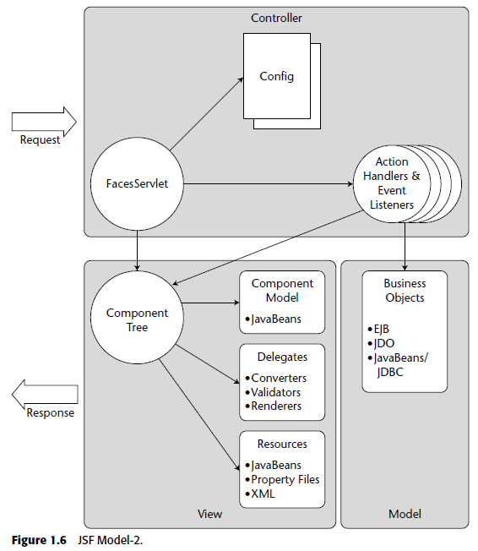
JSF ARCHITECTURE

Slide 6
JSF ADVANTAGES
a separation between behavior and presentation.
ui component reuse (*)
provides a rich architecture for
managing component state
processing component data,
validating user input and handling events …

Slide 7
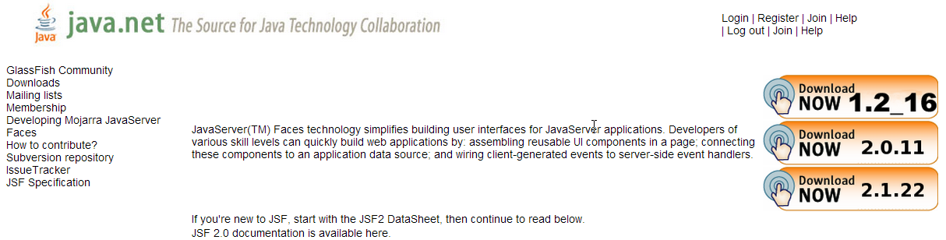
DOWNLOAD JSF ORACLE IMPLEMENTATION
MOJARRA PROJECT
https://javaserverfaces.java.net/

Slide 8
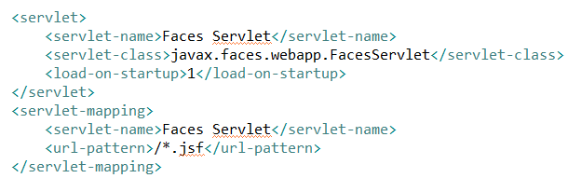
WORKING WITH JSF (1)
THE CONTROLLER
ADD FacesServlet TO web.xml

Slide 9
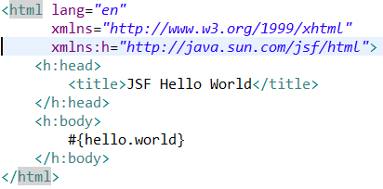
WORKING WITH JSF (2)
THE VIEW
The web page connects to the managed bean through the Expression Language (EL) value expression
hello.xhtml
Notes:
The web page connects to the managed bean through the Expression Language (EL) value expression #{hello.world}, which retrieves the value of the world property from the managed bean Hello. Note the use of hello to reference the managed bean Hello. If no name is specified in the @ManagedBean annotation, the managed bean is always accessed with the first letter of the class name in lowercase.

Slide 10
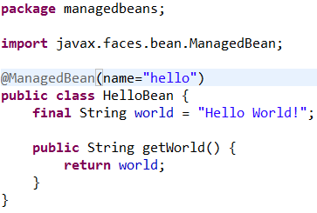
WORKING WITH JSF (3)
THE MANAGED (BACKING) BEAN
is a lightweight container-managed object.
Components (UI) in a page are associated with managed beans that provide application logic.
HelloBean.java

Slide 11
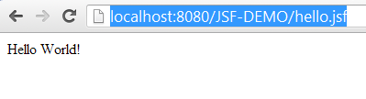

RUN DEMO
http://localhost:8080/JSF-DEMO/hello.jsf

Slide 12

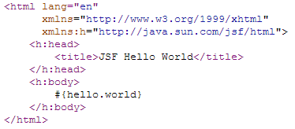
RUN DEMO
http://localhost:8080/JSF-DEMO/hello.xhtml

Slide 13
NOTES
A JSF page is represented by a tree of UI components.
JSF is an attempt to provide more Swing-like components for Web GUIs.

Slide 14
MORE ON JSF CONTROLLER
THE FacesServlet
The FacesServlet is responsible for receiving incoming requests from Web clients and then performing a logical set of steps (phrases) for preparing and dispatching a response.
JSF REQUEST LIFECYCLE

Slide 15
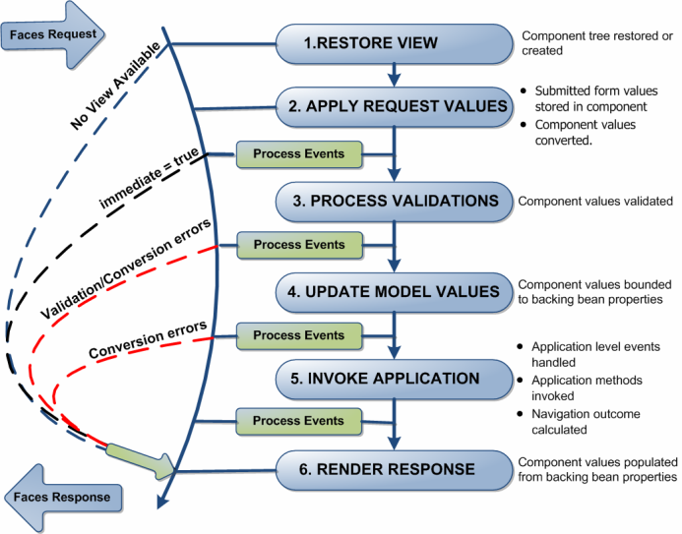
JSF REQUEST LIFECYCLE
Notes:
http://www.developersbook.com/jsf/jsf-tutorials/jsf-tutorials.php

Slide 16
JSF REQUEST LIFECYCLE
1. RESTORE VIEW
The JSF framework controller uses the view ID (typically JSP name) to look up the components for the current view.
If the view isn’t available, the JSF controller creates a new one.
If the view already exists, the JSF controller uses it.
The view contains all the GUI components and there is a GREAT WORK of state management by JSF to track the status of the view – typically using HTML hidden fields.
If the request for the page is an initial request, JSF creates an empty view during this phase. Lifecycle only executes the restore view and render response phases because there is no user input or actions to process.
If the request for the page is a postback, a view corresponding to this page already exists. During this phase, the JavaServer Faces implementation restores the view by using the state information saved on the client or the server. Lifecycle continues to execute the remaining phases.

Slide 17
JSF REQUEST LIFECYCLE
2. APPLY REQUEST VALUES
The request parameters are read and their values are used to set the values of the corresponding UI components.
If the conversion of the value fails, an error message associated with the component is generated and queued on FacesContext. This message will be displayed during the render response phase, along with any validation errors resulting from the process validations phase.
If some components on the page have their immediate event handling property is set to true, then the validation, conversion, and events associated with these components takes place in this phase instead of the Process Validations phase. For example, you could have a Cancel button that ignores all values on a form.

Slide 18
JSF REQUEST LIFECYCLE
3. PROCESS VALIDATION
All registered validators of the components is called.
The components validate the new values coming from the request against the application's validation rules.
Any input can be scanned by any number of validators.
These Validators can be pre-defined OR defined by the developer.
Any validation errors will abort the request–handling process and skip to rendering the response with validation and conversion error messages.

Slide 19
JSF REQUEST LIFECYCLE
4. UPDATE MODEL VALUE
Each UI component UPDATES BACKING BEANS.
CONVERTORS are invoked to parse string representations of various values to their proper primitive or object types. If the data cannot be converted to the types specified by the bean properties, the life cycle advances directly to the render response phase so that the page is re-rendered with errors displayed.
Note:
Apply Request Values phase: moves values from client–side HTML form controls to server–side UI components;
Update Model Value phase: moves values from the UI components to the backing beans.

Slide 20
JSF REQUEST LIFECYCLE
5. INVOKE APPLICATION PHASE
process the action event generated by the submit button that the user clicked.
Application level events handled
Application methods invoked
Navigation outcome calculated

Slide 21
JSF REQUEST LIFECYCLE
6. RENDER RESPONSE
Based on the result of the request processing, a response will be generated from the current component tree or a new component tree.
Values are transferred back to the UI components from the bean (Including any modifications)
The UI components save their state – not just their values, but other attributes having to do with the presentation itself. This can happen server–side, but by default state is written into the HTML as hidden input fields and thus returns to the JSF implementation with the next request.
If the request is a postback and errors were encountered during the apply request values phase, process validations phase, or update model values phase, the original page is rendered during this phase.
If the pages contain message or messages tags, any queued error messages are displayed on the page.

Slide 22
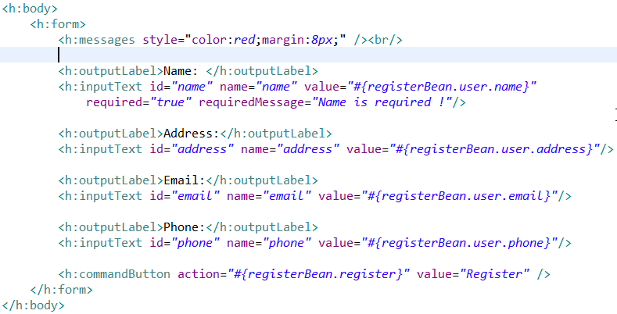
JSF REGISTER DEMO
register.xhtml

Slide 23
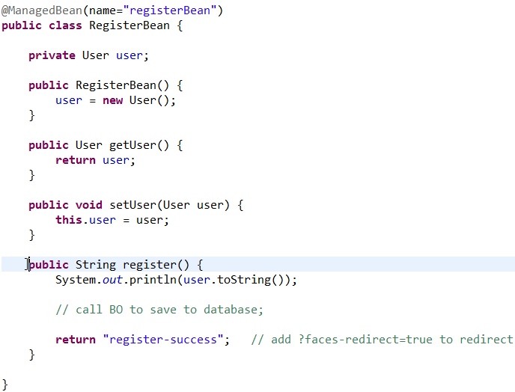
JSF REGISTER DEMO
RegisterBean.java

Slide 24
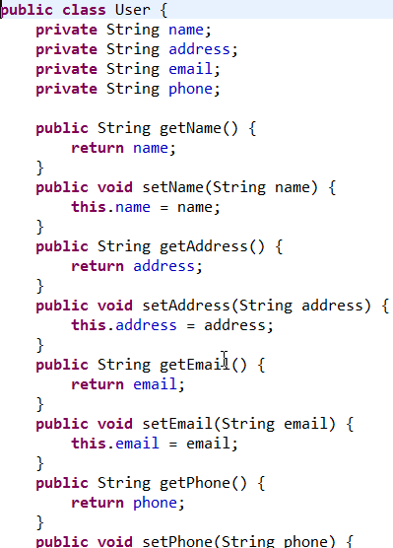
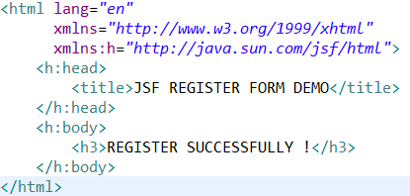
JSF REGISTER DEMO
User.java & register-success.xhtml

Slide 25
JSF TAGS REFERENCE
HTML TAGS
CORE TAGS
COMPOSITE TAGS
http://www.jsftoolbox.com/documentation/help/12-TagReference/index.jsf

Slide 26
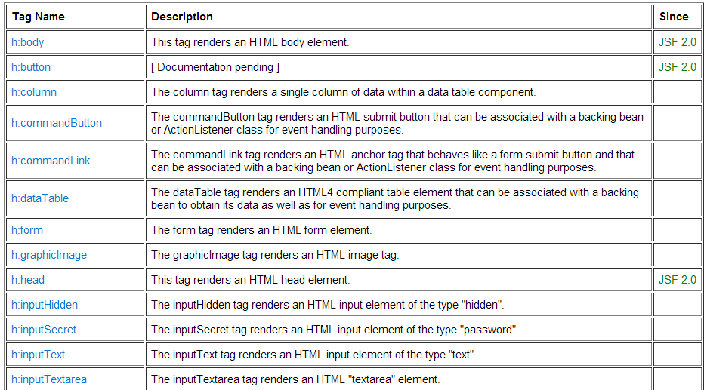
JSF TAGS REFERENCE
HTML TAGS (1)

Slide 27
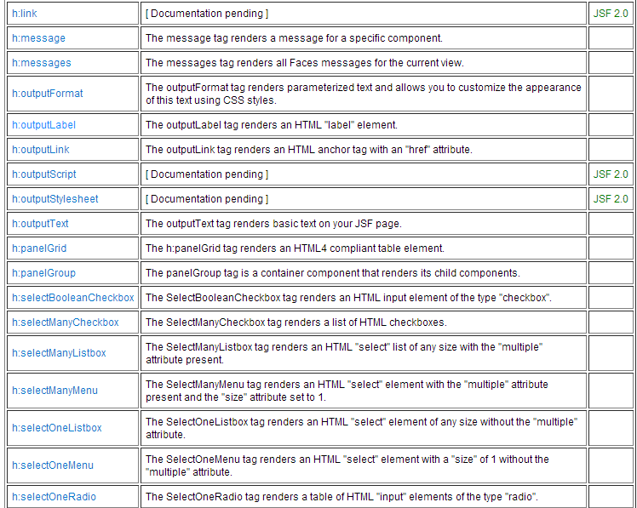
JSF TAGS REFERENCE
HTML TAGS (2)

Slide 28
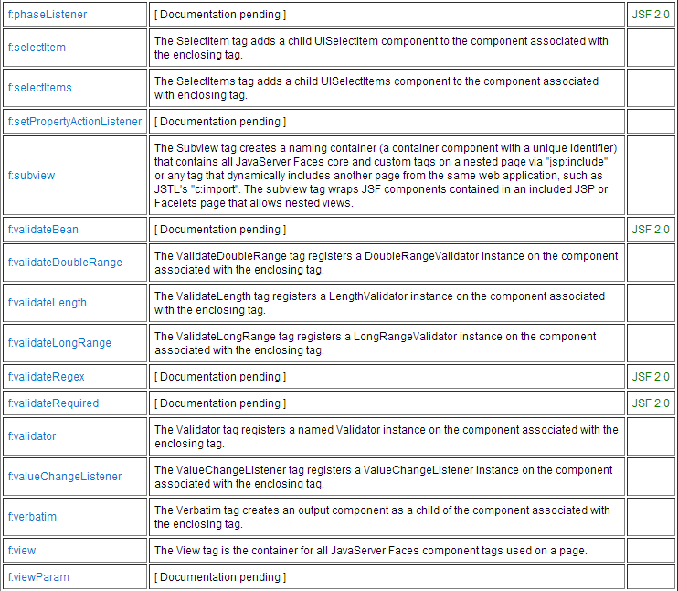
JSF TAGS REFERENCE
CORE TAGS (2)

Slide 29
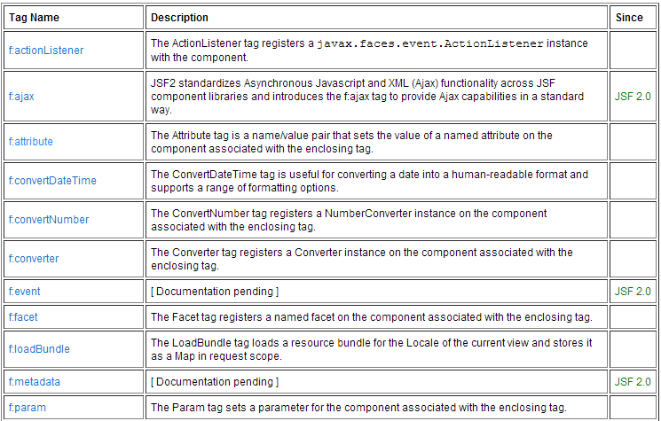
JSF TAGS REFERENCE
CORE TAGS (1)
Contains general purpose tags for conversion, validation, Ajax, and other use cases.

Slide 30
JSF TAGS REFERENCE
CORE TAGS (12)

Slide 31
JSF COMPONET ARCHITECTURE
IS DESIGNED AS
THE FUNCTIONALITY OF COMPONENT IS DEFINED IN COMPONENT CLASS
THE VIEW OF COMPONENT IS DEFINED IN RENDER CLASS
THE RENDER KIT defines a set of render classes for each component.
JSF includes a standard HTML render kit for rendering to an HTML client.
Notes:
The JavaServer Faces component architecture is designed such that the functionality of the components is defined by the component classes, whereas the component rendering can be defined by a separate renderer class. This design has several benefits, including the following:
Component writers can define the behavior of a component once but create multiple renderers, each of which defines a different way to render the component to the same client or to different clients.
Page authors and application developers can change the appearance of a component on the page by selecting the tag that represents the appropriate combination of component and renderer.
A render kit defines how component classes map to component tags that are appropriate for a particular client. The JavaServer Faces implementation includes a standard HTML render kit for rendering to an HTML client.
The render kit defines a set of javax.faces.render.Renderer classes for each component that it supports. Each Renderer class defines a different way to render the particular component to the output defined by the render kit. For example, a UISelectOne component has three different renderers. One of them renders the component as a set of radio buttons. Another renders the component as a combo box. The third one renders the component as a list box. Similarly, a UICommand component can be rendered as a button or a hyperlink, using the h:commandButton or h:commandLink tag. The command part of each tag corresponds to the UICommand class, specifying the functionality, which is to fire an action. The Button orLink part of each tag corresponds to a separate Renderer class that defines how the component appears on the page.

Slide 32
JSF UI COMPONENT
Every UI components implements javax.faces.component.UIComponent interface.
This interface defines methods for:
Navigating the component tree.
Interacting with backing beans
Component validation, data conversion …
UIComponentBase
Notes:
So what makes a user interface component? Every user interface component
in JSF implements the javax.faces.component.UIComponent interface.
This comprehensive interface defines methods for navigating the component
tree, interacting with backing data models, and managing supporting concerns
such as component validation, data conversion, rendering, and a host of
others. A convenient base class that implements this interface, javax.faces
.component.UIComponentBase, is provided for creating new components.
It provides default implementations for each method that component developers
can then extend to customize the behavior of a component.

Slide 33
HOW TO CREATE
A NEW JSF COMPOENT
CREATE A NEW CLASS that implements UIComponent interface
EXTENDS UIComponentBase class.
EXTENDS UIComponentBase subclass.
JSF provide a rich set of standard JSF components .
Mostly, we just need to customize it

Slide 34
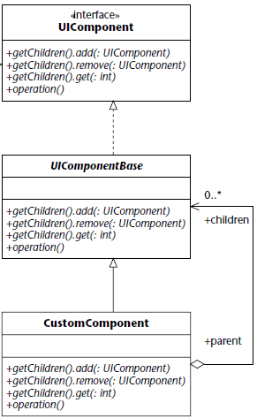
HOW TO CREATE
A NEW JSF COMPOENT

Slide 35
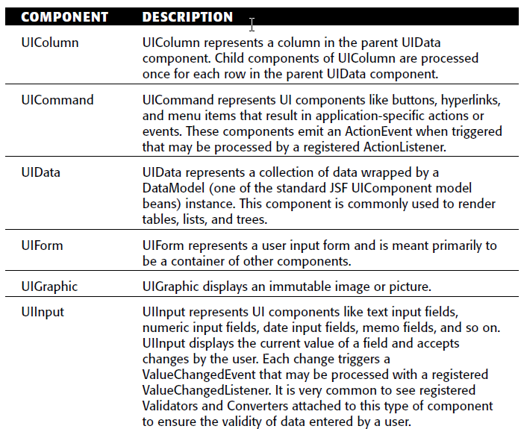
STANDARD JSF COMPONENTS

Slide 36
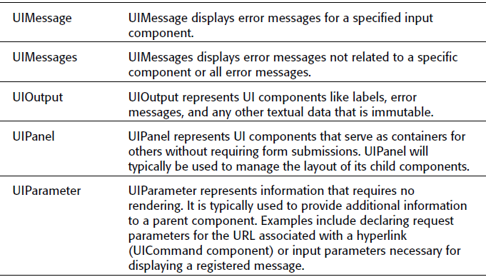
STANDARD JSF COMPONENTS

Slide 37
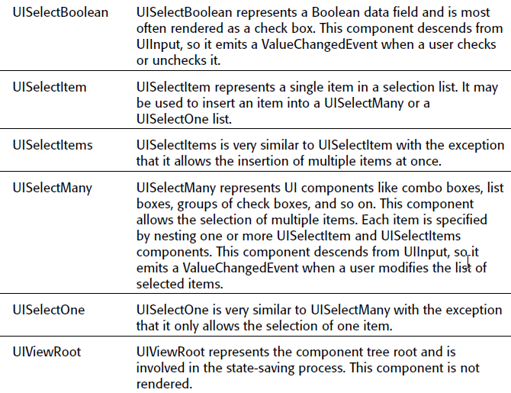
STANDARD JSF COMPONENTS

Slide 38
STANDARD JSF COMPONENTS
(2.0)
UIViewParameter: Represents the query parameters in a request. This class is a subclass of theUIInput class.
UIOutcomeTarget: Displays a hyperlink in the form of a link or a button.

Slide 39
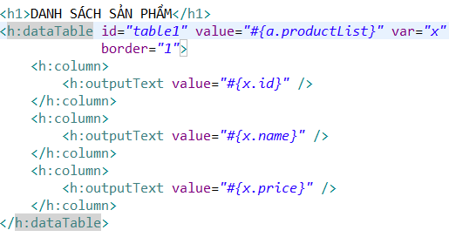
PRACTICE:
USING DATA TABLE
using-data-table-1.xhtml

Slide 40
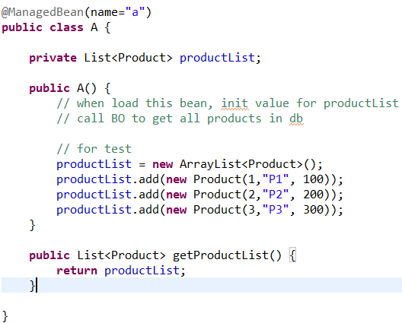
PRACTICE:
USING DATA TABLE
A.java

Slide 41
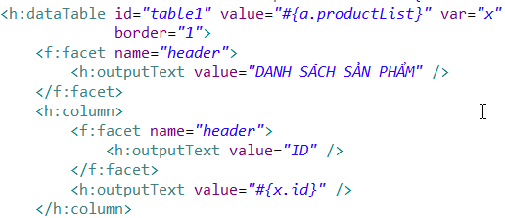
PRACTICE:
USING DATA TABLE
USING <facet>

Slide 42
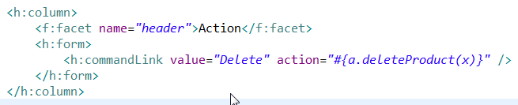
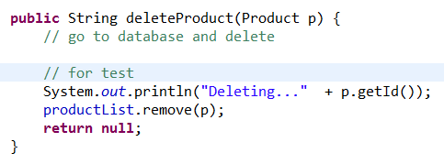
PRACTICE:
USING DATA TABLE
ADD “delete” FUNCTION

Slide 43
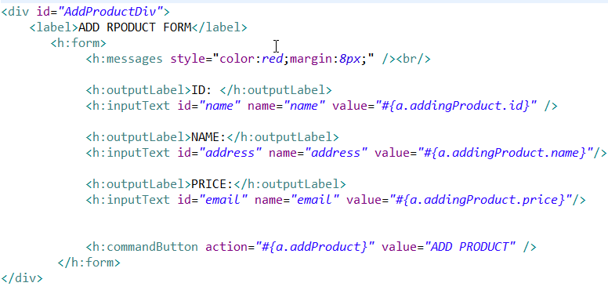
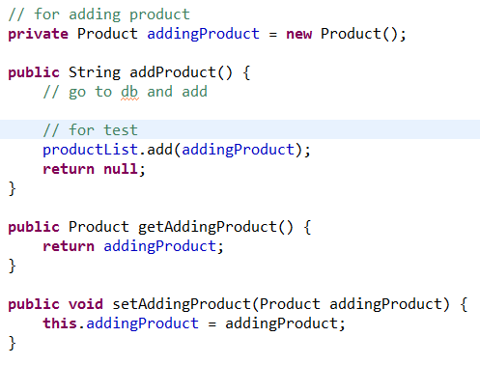
PRACTICE:
USING DATA TABLE
ADD “add” FUNCTION

Slide 44
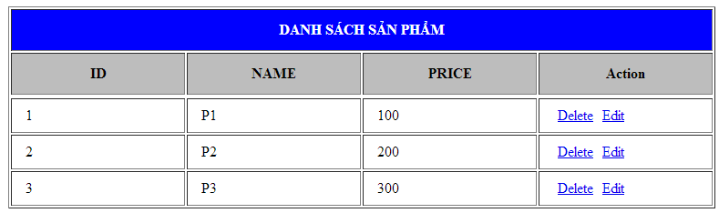
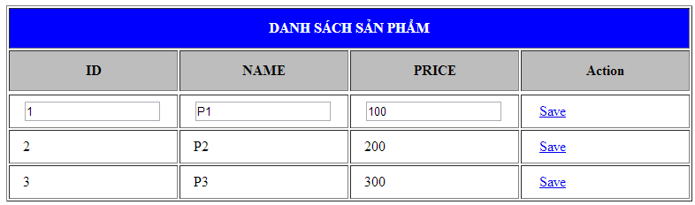
PRACTICE: USING DATA TABLE
EDIT FUNCTION
DEMO

Slide 45
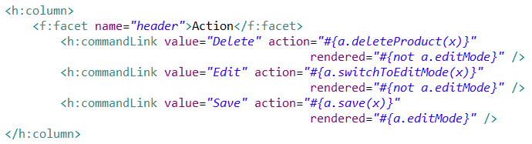
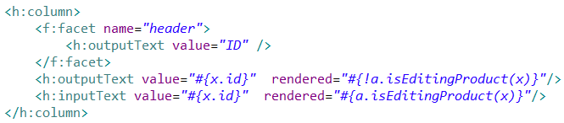
PRACTICE: USING DATA TABLE
EDIT FUNCTION

Slide 46
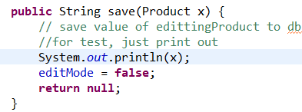
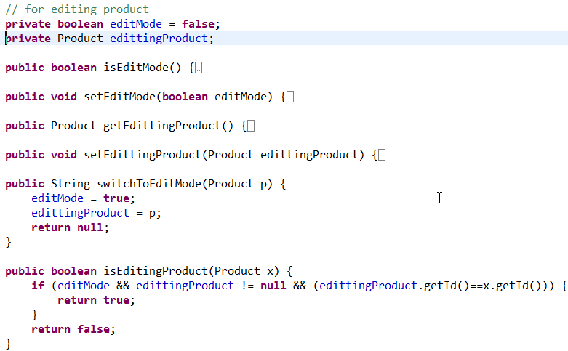
PRACTICE: USING DATA TABLE
EDIT FUNCTION
A.java

Slide 47
JSF VALIDATOR
JSF provide a set of classes & associated tags to validate component data.

Slide 48
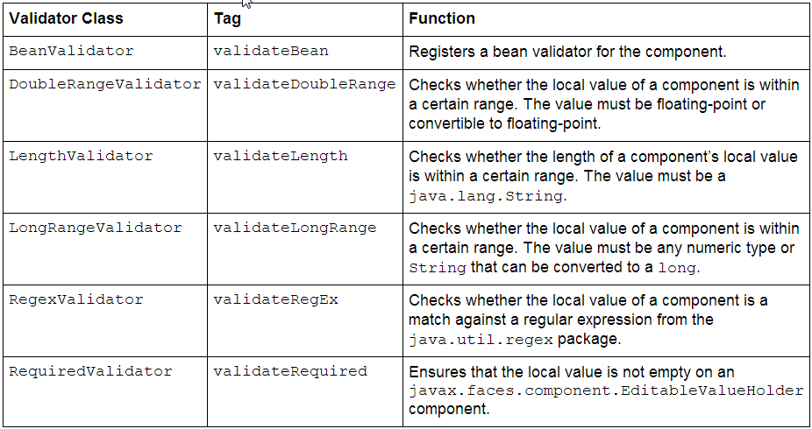
JSF VALIDATOR

Slide 49



JSF VALIDATOR EXAMPLE

Slide 50
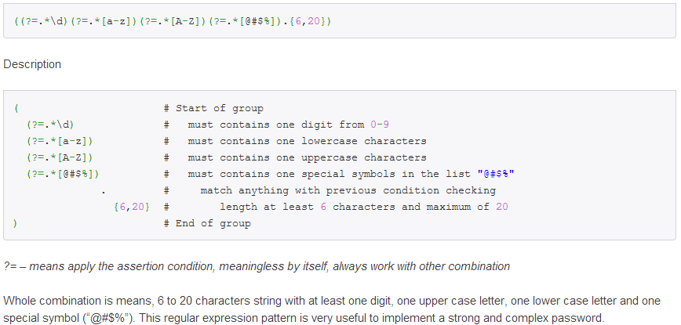
JSF VALIDATOR EXAMPLE
http://www.mkyong.com/regular-expressions/how-to-validate-password-with-regular-expression/

Slide 51
JSF VALIDATOR EXAMPLE
<f:validateBean> tag assigns the validation of local value to the Bean Validation API
Notes:
As for the libs, I've inluded the "validation-api-1.0.0.GA.jar" both in the "WEB-INF/lib" folder and also the "apache-tomcat-7/lib" folder.
You've installed only the API, not the implementation. The API is an abstract contract so that you can declare/use it in your code and have the freedom in choosing the implementation. The implementation contains the concrete code and does the real work. You need to install the impl as well. The JSR-303 reference implemtation is the Hibernate Validator. The download details are here. Currently the latest final is 4.1.0. It contains the hibernate-validator-4.1.0.Final.jar file which is the real implementation. Drop it in Webapp/WEB-INF/lib. It does not necessarily need to be in Tomcat7/lib, I'd remove the API from there as well to prevent future classpath collisions.
http://www.hibernate.org/subprojects/validator/download

Slide 52
PRIME FACES

Slide 53
WHAT IS PRIMEFACES ?
PrimeFaces is an open source JSF component suite
* Rich set of components (HtmlEditor, Dialog, AutoComplete, Charts…).
• Built-in Ajax based on standard JSF 2.0 Ajax APIs.
• Lightweight, one jar, zero-configuration and no required dependencies.
• Ajax Push support via websockets.
• Mobile UI kit to create mobile web applications for handheld devices.
• Skinning Framework with 35+ built-in themes and support for visual theme designer tool.

Slide 54

HOW TO INSTALL PRIMEFACES
ADD “primefaces-xxx.jar” to WEB-INF/lib folder.
DECLARE primcefaces tags
http://www.primefaces.org/downloads.html

Slide 55
PRIMEFACES
COMPONENT DEMO
http://www.primefaces.org/showcase/ui/home.jsf

Slide 56
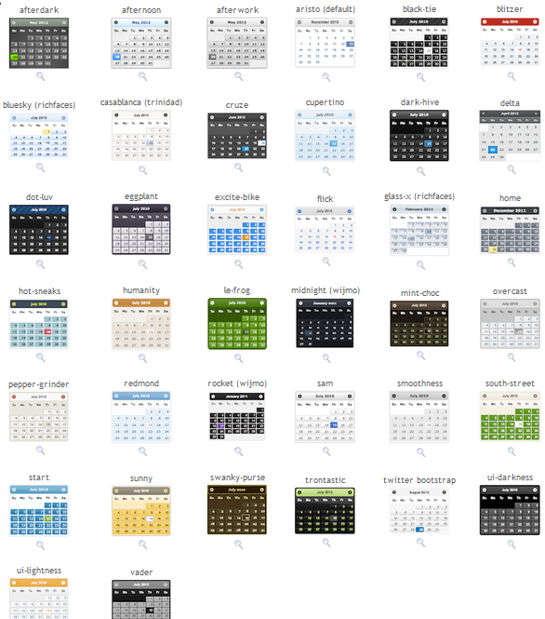

APPLY THEMES
DOWNLOAD THE THEMES AND ADD IT TO WEB-INF/lib FOLDER
CONFIRUE web.xml
http://www.primefaces.org/themes.html

Slide 57
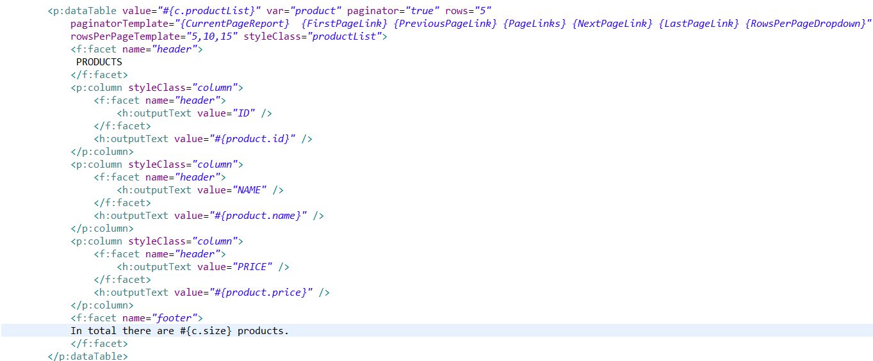
<p:dataTable>
Pagination (1)

Slide 58
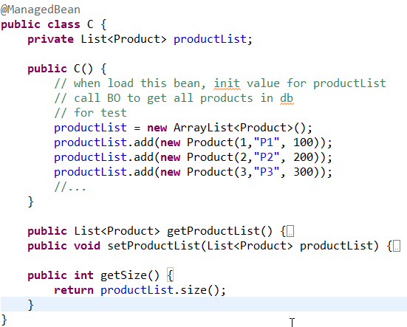
<p:dataTable>
Pagination (2)

Slide 59

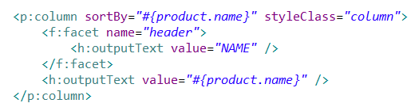
<p:dataTable>
sorting

Slide 60

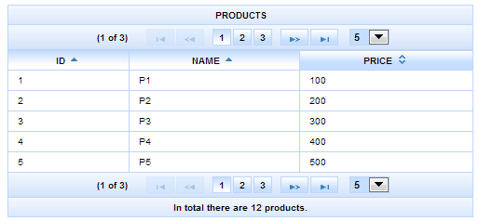
<p:dataTable>
Multi sorting
SORT BY MULTI COLUMN (press Ctrl key to select multi columns)

Slide 61
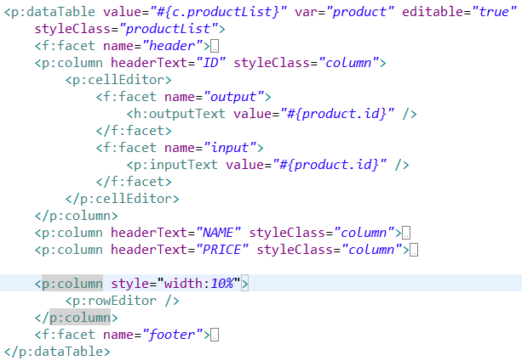
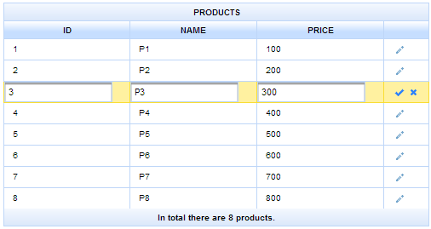
<p:dataTable>
Row Edit

